Slide 1



OBE Implementation
Module-8:Course Objective Setting

Slide 2
Introduction to Project
Course Objective Setting (herewith considered as SRM-AP) is going to implement OBE(Outcome Based Education) in their university and you are assigned in the project to develop a CURD(Create,Update,Retrieve and Delete) windows.
Course Objective Setting is a crucial part of implementing Outcome Based Education (OBE). It involves defining what students should be able to achieve by the end of a course. These objectives guide teaching strategies, assessment methods, and help align Course Outcomes (COs) with Program Outcomes (POs), ensuring a structured and measurable learning process.
CRUD Operations:
Create: Add new course objectives
Read/Retrieve: View existing objectives
Update: Edit or revise course objectives
Delete: Remove outdated or incorrect objectives

Slide 3
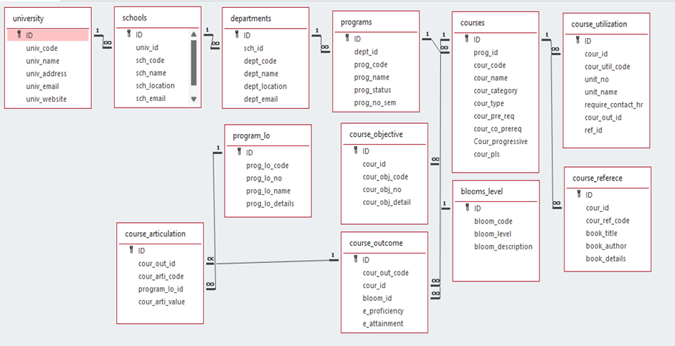
Architecture Diagram

Slide 4

Module Description : Course Objective Setting
●
This module is used to create,Update,Retrieve,Delete(hereafter known as CURD) details of the module and storing the details in the mysql table.
●
The Course Objective Setting module is an important part of the Outcome Based Education (OBE) system. It allows faculty members to define clear and specific learning goals for each course. These goals, known as course objectives, describe what students should know or be able to do by the end of the course. Setting these
objectives helps in creating meaningful course content, selecting appropriate teaching methods, and designing effective assessments.
This module ensures that the course objectives are aligned with the overall goals of the academic program. When used correctly, it supports consistent and measurable learning progress. Faculty can regularly review and update the objectives to keep them relevant and accurate. By using this module, the university can improve the quality of education and help students achieve better results.
●

Slide 5

Course Objective Setting
Field Name
Data type
id
integer
cour_id
String
cour_obj_code
String
cour_obj_no
String
cour_obj_detail
String

Slide 6
Course Objective Setting: Programming Details
● ●
File name:
CodeBrew_CourseObjective.java
Function/method name
○ ○ ○ ○
Create: Update: Retrieve:
CourseObjective_CreateForm
CourseObjective_Update
CourseObjective_Retrieve
Delete:
CourseObjective_Delete

Slide 7
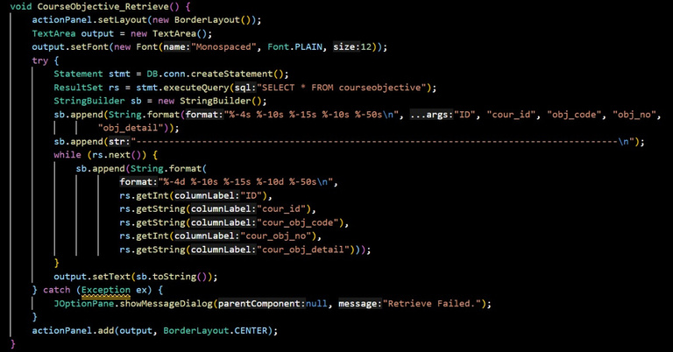
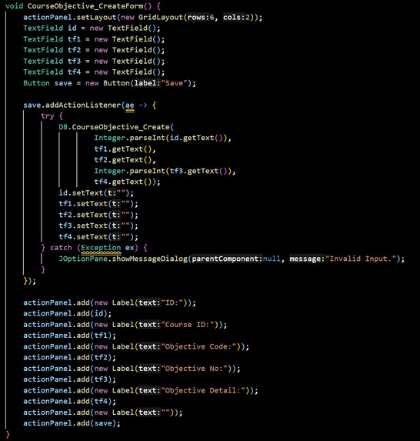
Sample Source Code:

Slide 8

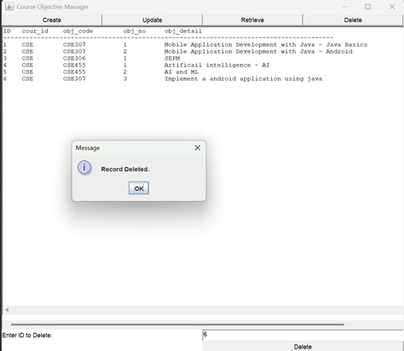
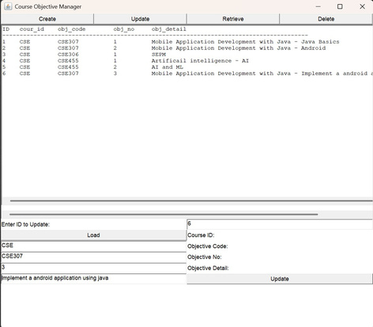
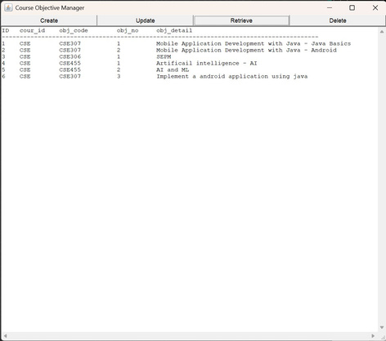
Sample Screen Shots

Slide 9
Conclusion
The Course Objective Setting module successfully supports the OBE implementation at SRM University-AP by allowing easy creation, updating, and management of course objectives. With a simple CRUD functionality and integration into the overall academic system, it helps streamline the process and ensures better alignment of course goals with program outcomes.
This module ensures that course objectives are clearly defined and easily maintained, which is essential for continuous improvement in teaching and learning. By integrating it with other academic modules, it strengthens the overall structure of the OBE system and helps faculty align course delivery with desired outcomes.

Slide 10

Thank You
Jeelani Basha -AP22110010013
Hemanjali-AP22110010047
Avinash-AP22110010006
Pradeep-AP22110010005
Rahul-AP22110010052
Dhanyan-AP22110010032

